Slide 1
ENSE 470, Milestone 1
[Group name]
Shawn Clake, Nikolas Lendvoy, Amruo Hasnoon
September 18, 2018

Slide 2
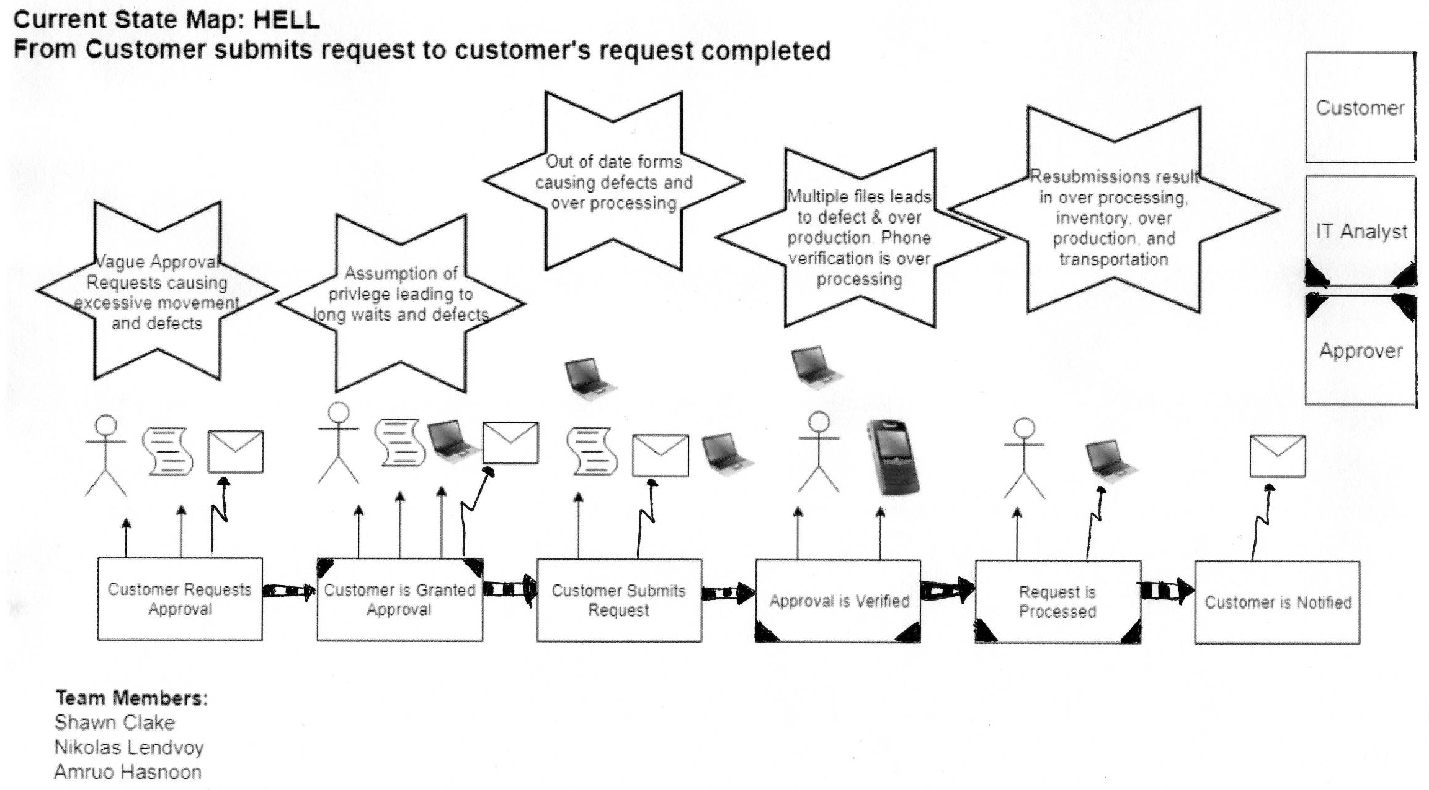
Current state Value Stream Map (VSM)

Slide 3
Group reflection
How did you feel about this milestone? What did you like about it? What did you dislike?
  The story was unclear near the end with regards to how certain processes are done. E.g. Customer notification
  Some of the arrow types were unclear.
What did you learn about yourself as you collaborated and worked through this milestone?
  My artistic skills are sub par.

Slide 4
Group reflection
How will you use what you have learned going forward?
  Using the CSM we can observe inefficiency and Kaizen bursts which will help with creating the FSM
What “stuff & things” related to this milestone would you want help with?
  Symbols. E.g. what symbols to use for Excel?
  Software suggestions for creating these maps easily considering the need for specific symbol types (arrows).

